Slide 1




Debugging of BPMN processes using coloration techniques
By Gwen SALAUN & Quentin NIVON

Slide 2






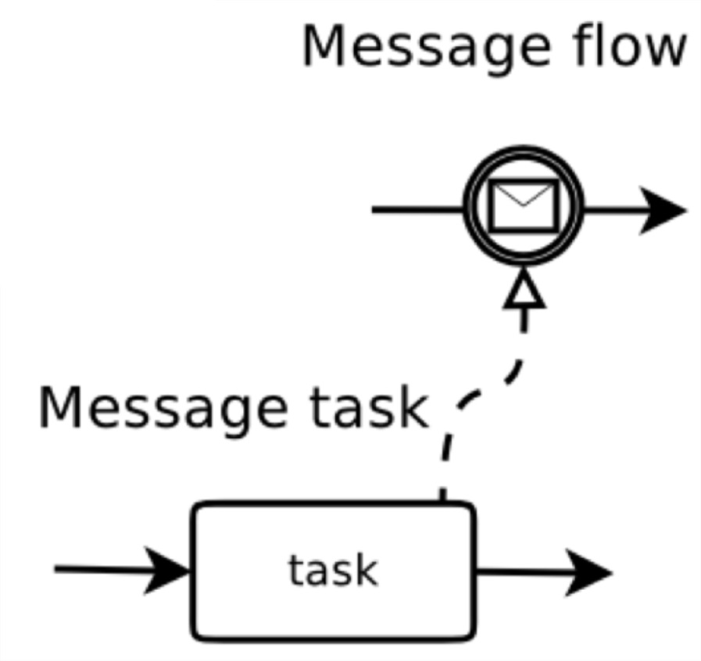





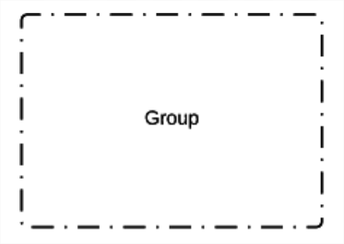
Introduction
What is BPMN?
A workflow-based notation created in 2004 by the Business Process Management Initiative (BPMI) and the Object Management Group (OMG).
It aims at representing business processes in a way that is understandable for both experienced and novice users.
An ISO/IEC standard since version 2.0 in 2013.
A rich syntax:
Association
Sequence Flow
Task
Initial Event
End Event
Annotation
Exclusive Gateway
Inclusive Gateway
Parallel Gateway
Event-based Gateway
Group

Slide 3
Introduction
Context
Companies are making use of the BPMN notation to represent their business processes.
Some of them are interested in performing behavioral verifications of their BPMN processes.
Existing solutions
Nowadays, companies are able to verify the validity of temporal logic properties over their BPMN processes.
To do so, they transform their BPMN processes into specifications understandable by a model checker which will verify the property.
In the end, they get one or several counterexamples that violate the property. Nonetheless, they are not expressed in BPMN notation.

Slide 4
Introduction
Motivations
Expressing all the counterexamples in BPMN notation to make it understandable for the initial user.
Remaining as syntactically close as possible to the original BPMN process.
Being as minimal as possible, in terms of number of nodes, in the BPMN process returned to the user.

Slide 5
Plan
Preliminaries
BPMN sub-syntax
Model checking & Colored LTS
Full process
Solving approach
Global representation
Matching analysis
Unfolding only
Unfolding + Folding
Implementation
Generalities
Empirical study
Performance study
Conclusion

Slide 6


Preliminaries: BPMN sub-syntax
In this work, we use a restrained subset of the entire BPMN syntax.
The subset syntax used contains (or plan to contain):
Gateways (exclusive, parallel, inclusive)
Sequence Flows
Tasks
Events (start, end)
But does not contain (or plan to contain):
Intermediary events
Message-based gateways
Message flows
Associations
Artifacts, data-objects
Occur in more than 90% of BPMN processes!
[Krishna, Poizat, Salaün – SCP 19]
Occur in less than 10% of BPMN processes.

Slide 7
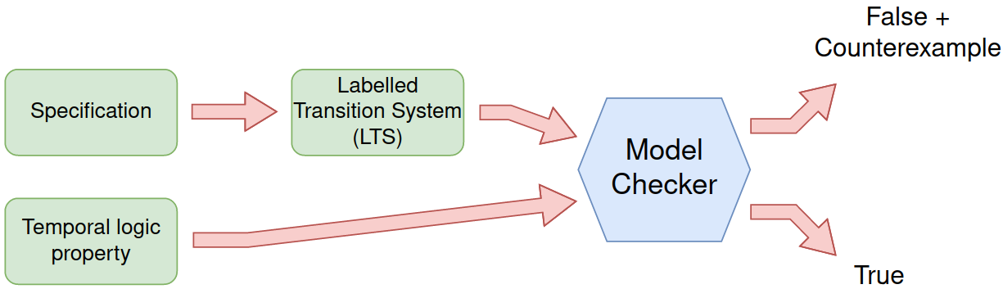
Preliminaries: Model Checking
The current work makes use of already existing techniques, such as model checking:

Slide 8
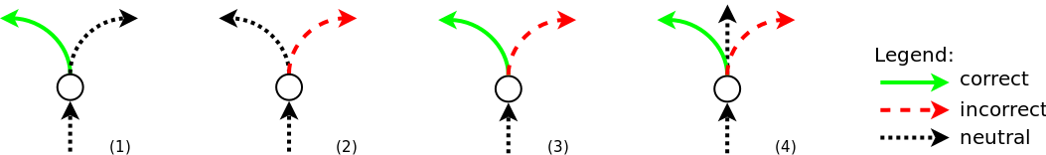
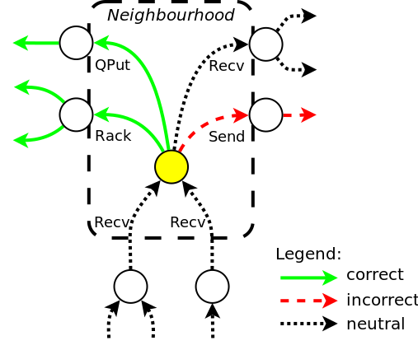
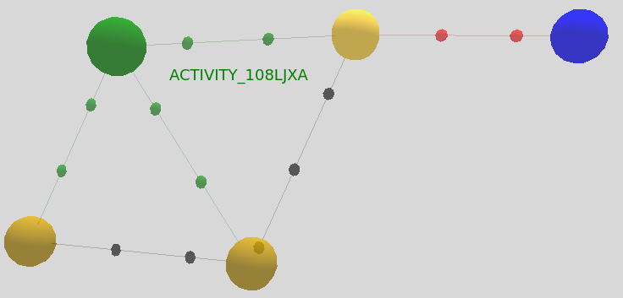
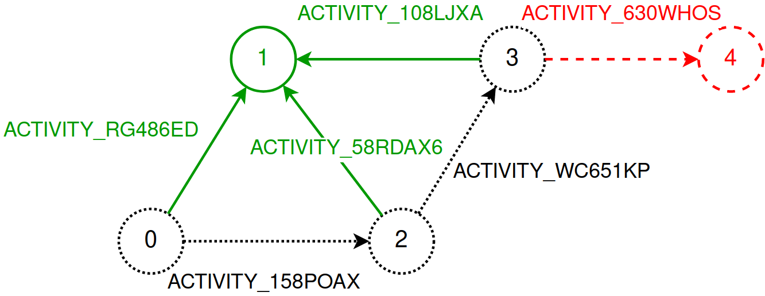
Preliminaries: Colored LTS
Or Colored LTS (CLTS):
Key idea 1: transitions categorisation (3 types)
correct transitions
incorrect transitions
neutral transitions
Key idea 2: identification of faulty states
choices between transitions leading to a correct or an incorrect part of the model
Four kinds of faulty states:
CLTS output from the CLEAR tool
Clearer representation of the CLTS output

Slide 9
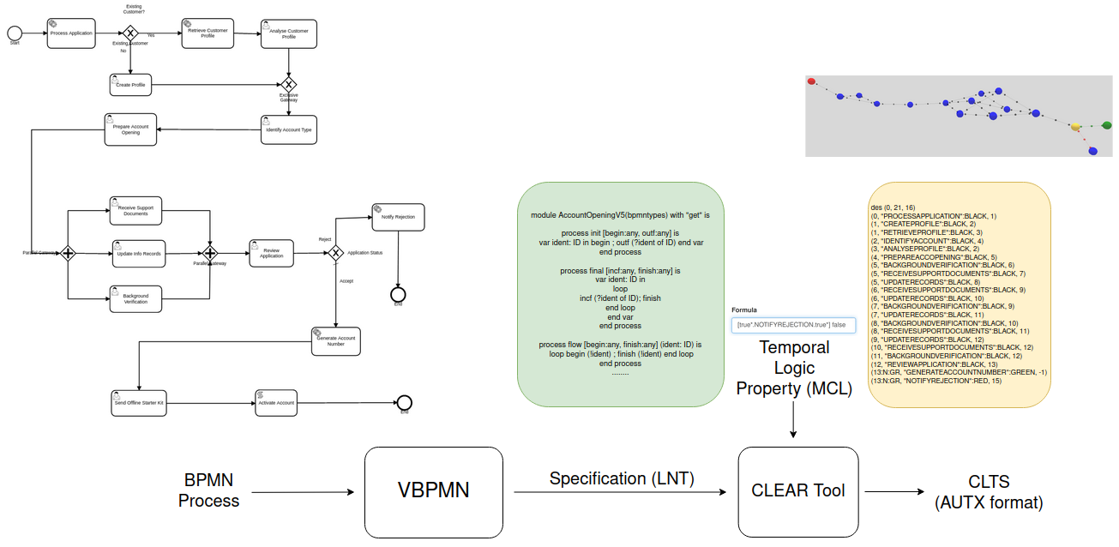
Preliminaries: Full process
The whole counterexample generation process can be modeled as follows:

Slide 10
Plan
Preliminaries
BPMN sub-syntax
Model checking & Colored LTS
Full process
Solving approach
Global representation
Matching analysis
Unfolding only
Unfolding + Folding
Implementation
Generalities
Empirical study
Performance study
Conclusion

Slide 11
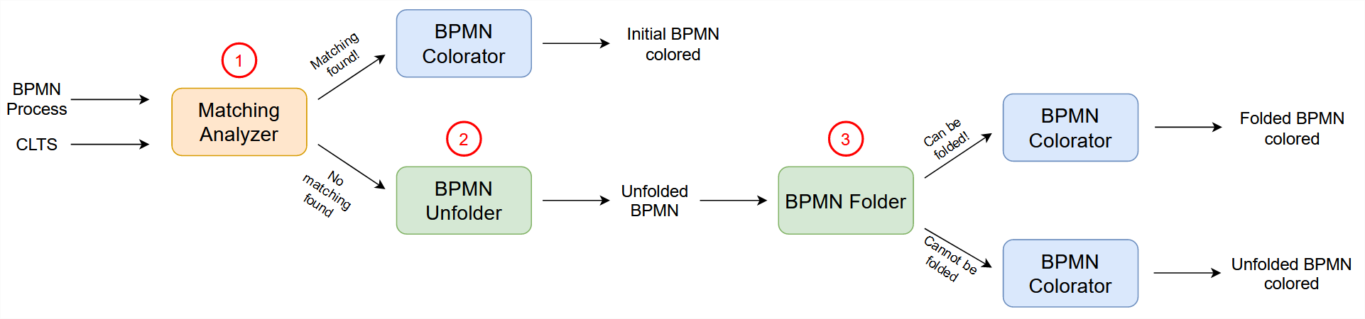
Solving approach: Global representation
The solving approach is a 3-step approach:
First, we try to find a matching between the CLTS and the BPMN process.
If no matching can be found, then the initial BPMN process is not directly colorable.
In such case, we generate a new BPMN process during the unfolding phase.
Finally, we try to fold this BPMN process in order to reduce its number of nodes.
1
2
3

Slide 12
Solving approach: Matching analysis – Idea
Main idea
The purpose of this step is to verify if the initial BPMN process is directly colorable regarding the property.
Algorithmically
We detect whether all the transitions of the CLTS having the same label are colored identically.
If so, we try to associate each faulty state of the CLTS to a unique node of the BPMN process.
A matching exists!
Then the initial BPMN process is colored directly
and returned to the user
No matching exists.
Then we build a new BPMN process from the CLTS and try to minimize it

Slide 13
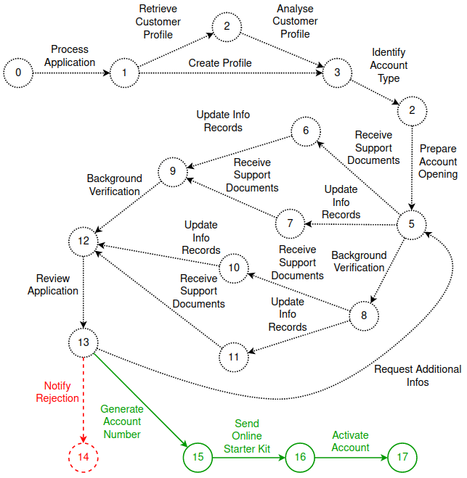
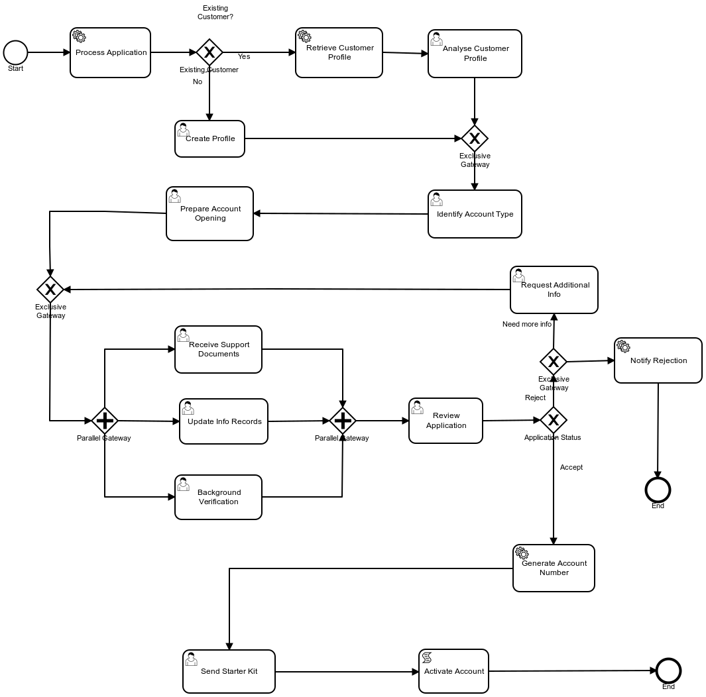
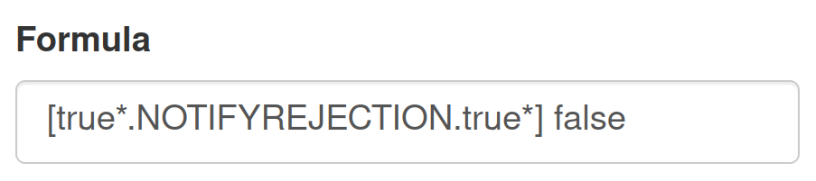
Solving approach: Matching analysis – Examples
Example 1: A perfect matching is found Step 1: Generation of the CLTS

Slide 14
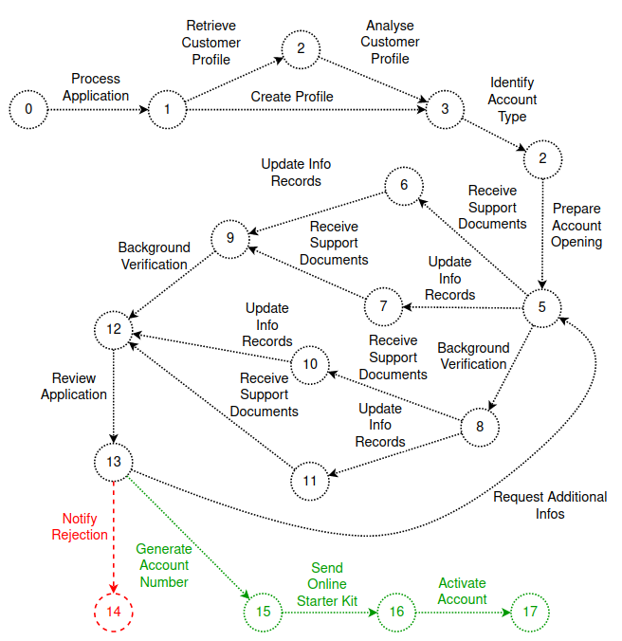
Solving approach: Matching analysis – Examples
Example 1: A perfect matching is found Step 2: Matching computation
Match!

Slide 15
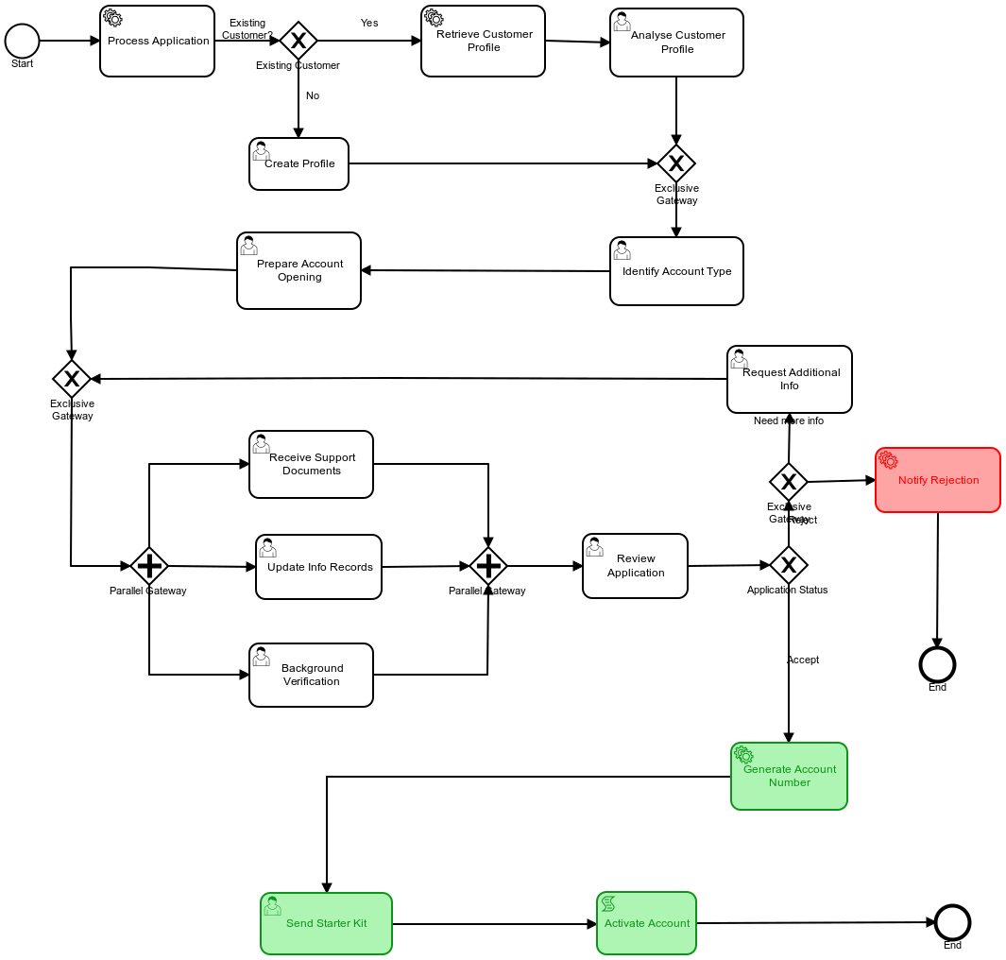
Solving approach: Matching analysis – Examples
Example 1: A perfect matching is found Step 3: Coloration is performed: Starting from each first red or green transition, we color each reachable BPMN task.

Slide 16
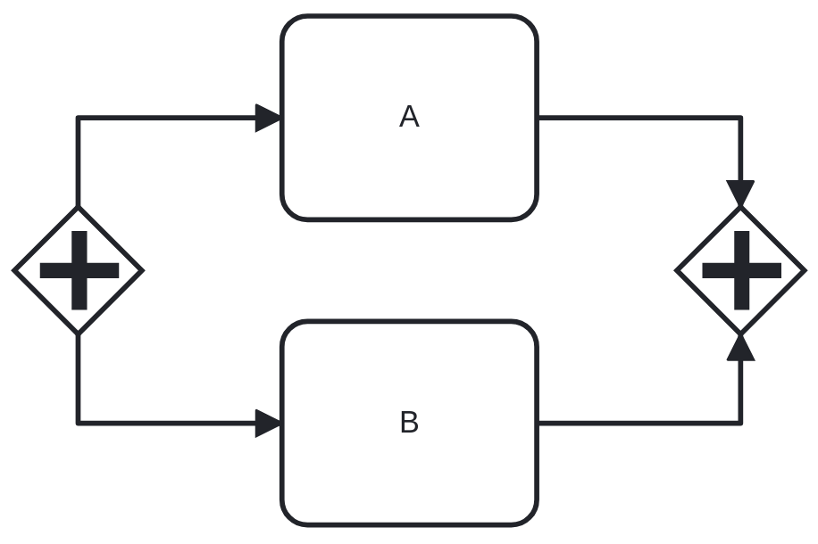
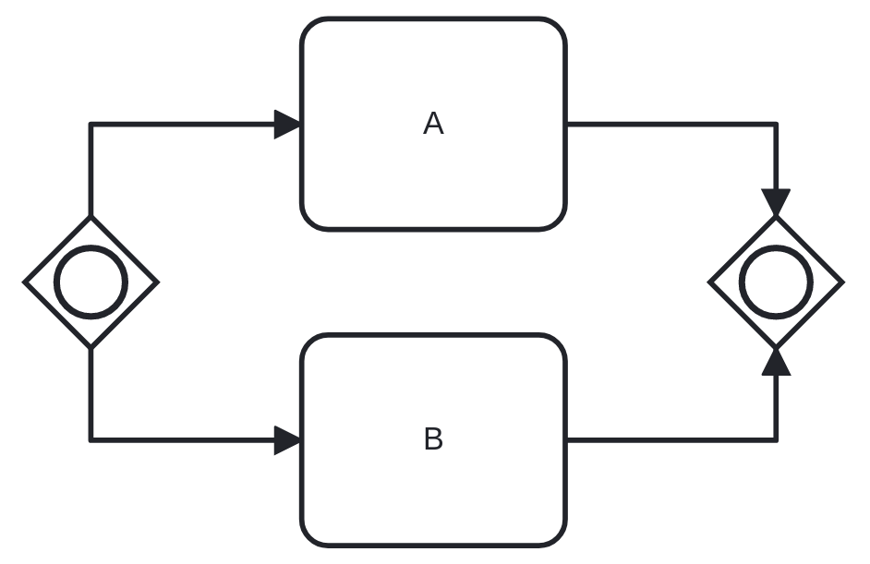
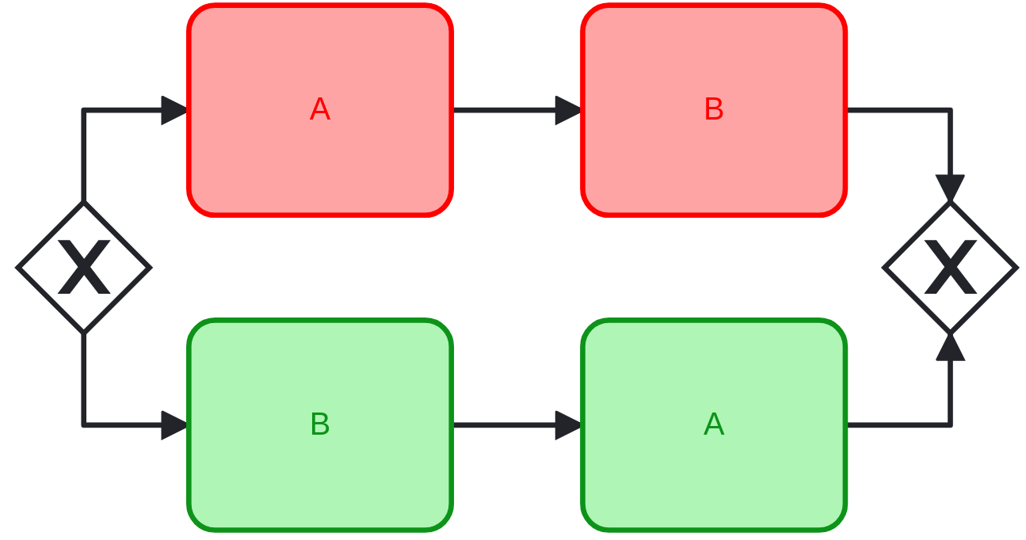
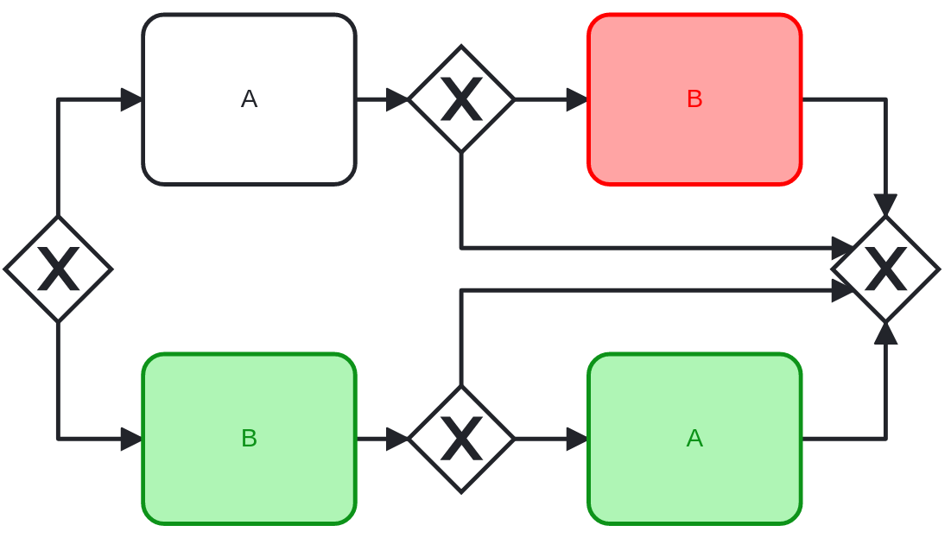
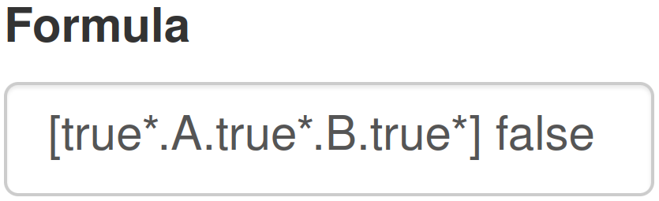
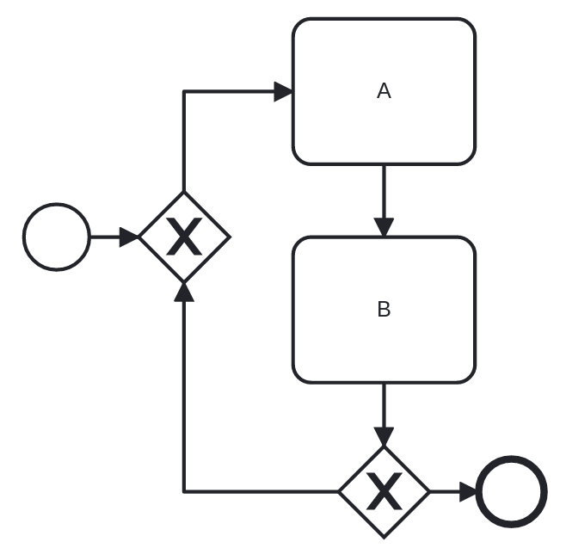
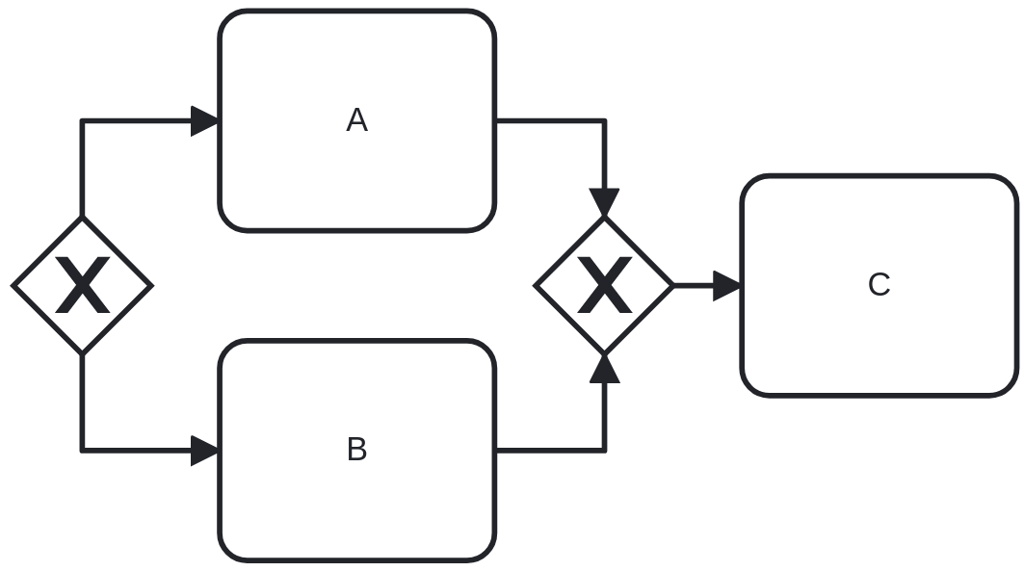
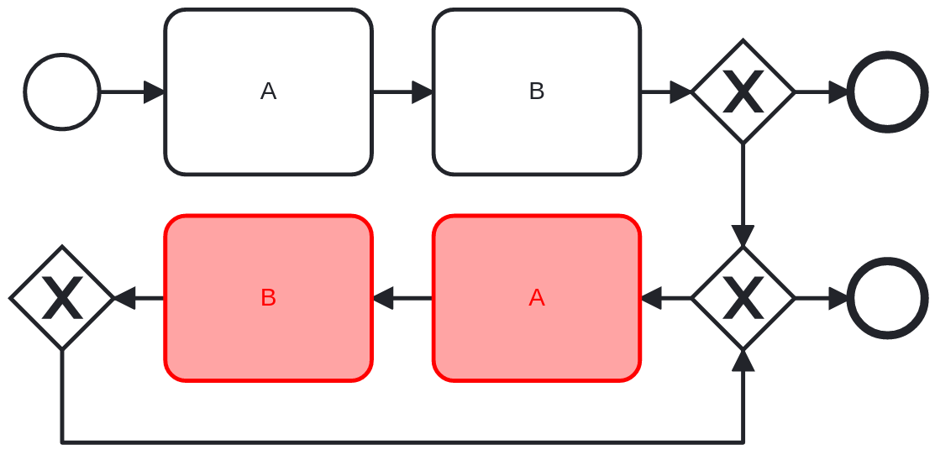
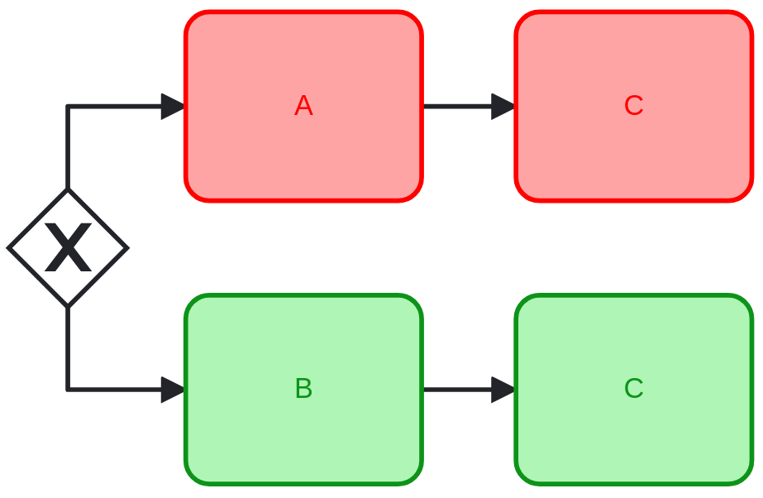
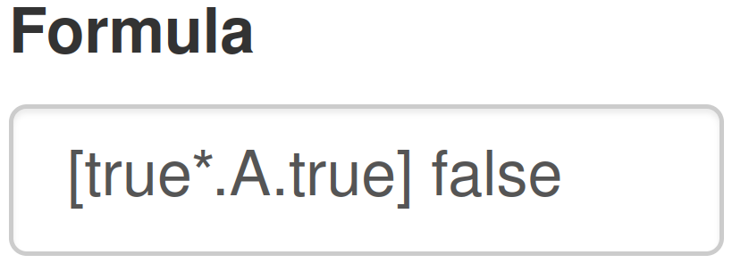
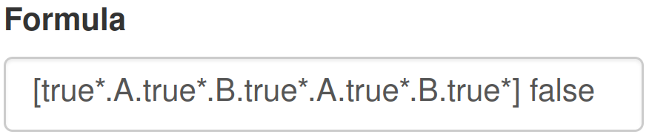
Solving approach: Unfolding
We transform the CLTS into a semantically equivalent BPMN process. As the CLTS is colored, the generated BPMN process is colorable regarding the property.
Case 1
Case 2
Case 3
Case 4

Slide 17
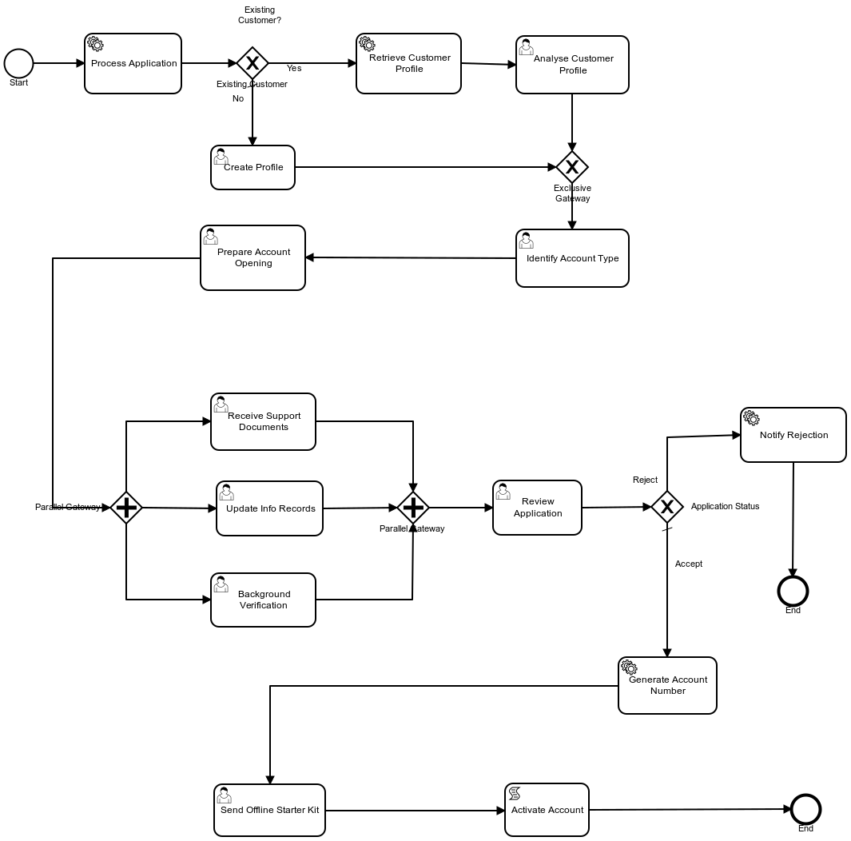
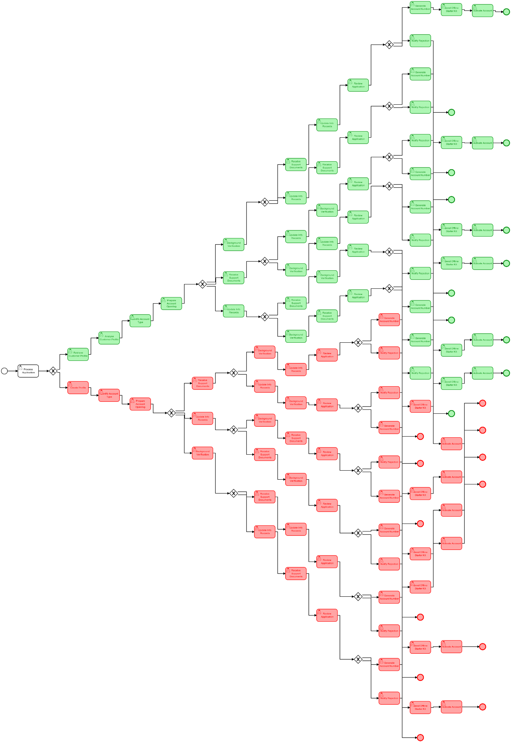
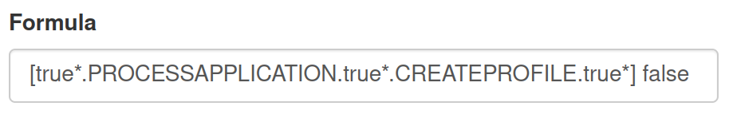
Solving approach: Unfolding
Drawback In some cases, the generated BPMN process can be very large, which may limit the understanding of the problem for the user.
Unfolding
14 tasks
98 tasks

Slide 18
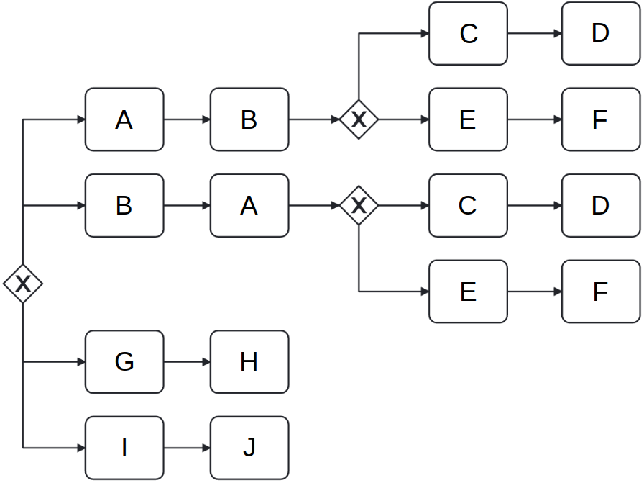
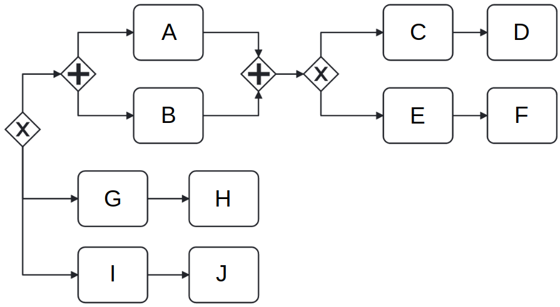
Solving approach: Unfolding + Folding
Main idea In this phase, we try to reduce the size – in terms of number of nodes – of the unfolded BPMN process to make it more understandable for the user. Our approach focuses on the detection of unfolded parallel gateways in order to replace them in the unfolded graph by their folded version.
Algorithmically
Out-of-scope paths (set 1)
Unfolded gateway
Out-of-scope paths
Folded gateway
Out-of-scope paths (set 2)
Impure paths
Impure paths

Slide 19
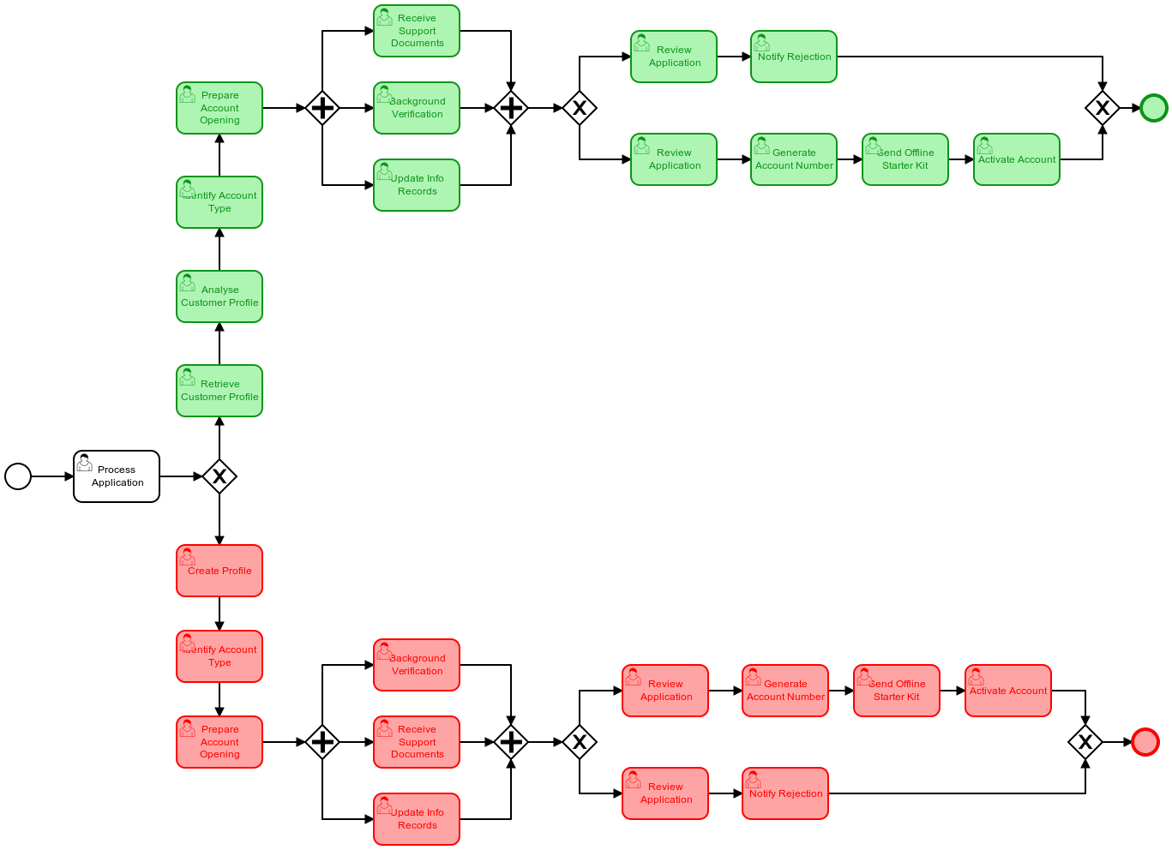
Solving approach: Unfolding + Folding – Example
Out-of-scope tasks
Parallel tasks
Out-of-scope tasks
Previous tasks
Parallel tasks
Previous tasks
Folding
98 tasks
26 tasks

Slide 20
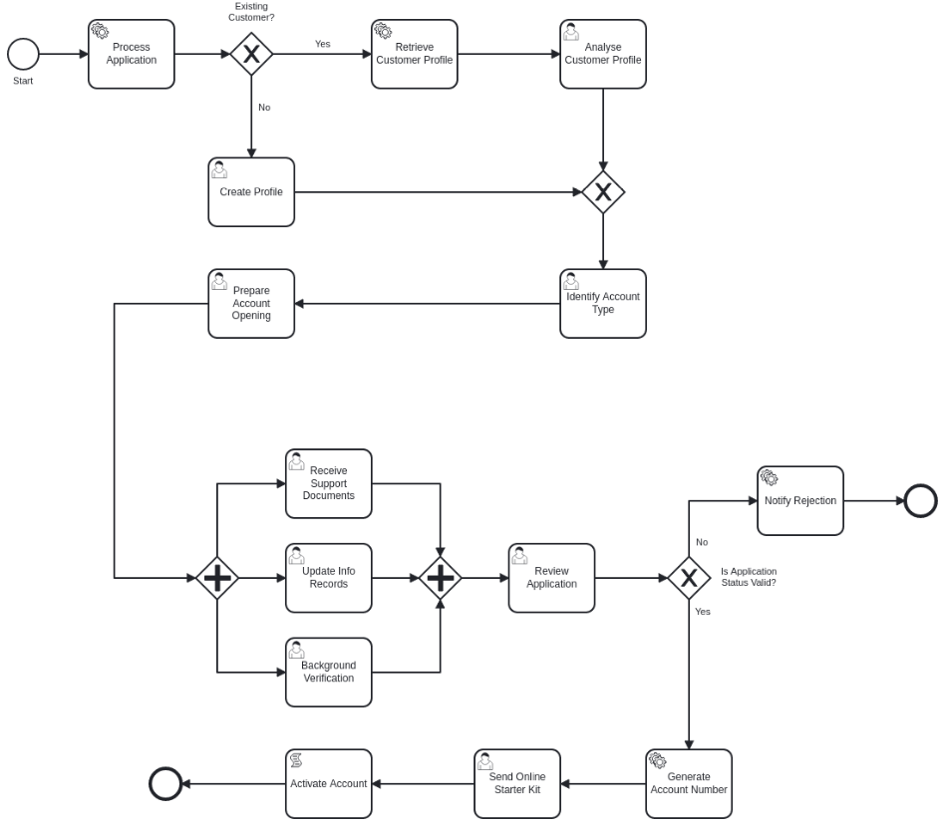
Solving approach: Unfolding + Folding – Example
Initial BPMN process (14 tasks)
Returned BPMN process (26 tasks)

Slide 21
Plan
Preliminaries
BPMN sub-syntax
Model checking & Colored LTS
Full process
Solving approach
Global representation
Matching analysis
Unfolding only
Unfolding + Folding
Implementation
Generalities
Empirical study
Performance study
Conclusion

Slide 22
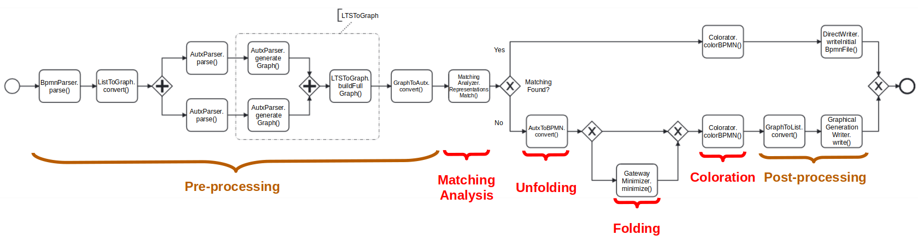
Implementation – Generalities
Prototype
The approach detailed in this presentation has been fully implemented and tested on more than 100 BPMN processes. It consists of approximately 10,000 lines of Java code.
Steps
In this presentation, we did not detail all the steps of the approach, which contain a lot of processing phases. These steps are detailed in the below figure.

Slide 23
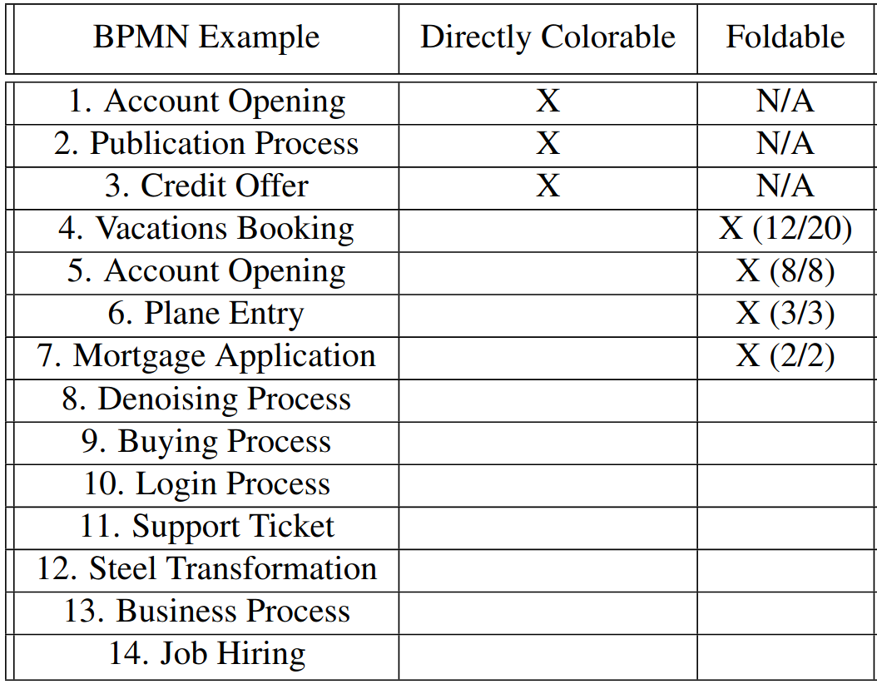
Implementation – Empirical study
Overall, the implemented part of the approach proposes the same BPMN process or a syntactically close one to the user in 50% of cases.
3/14
=
21%
4/14
=
29%

Slide 24
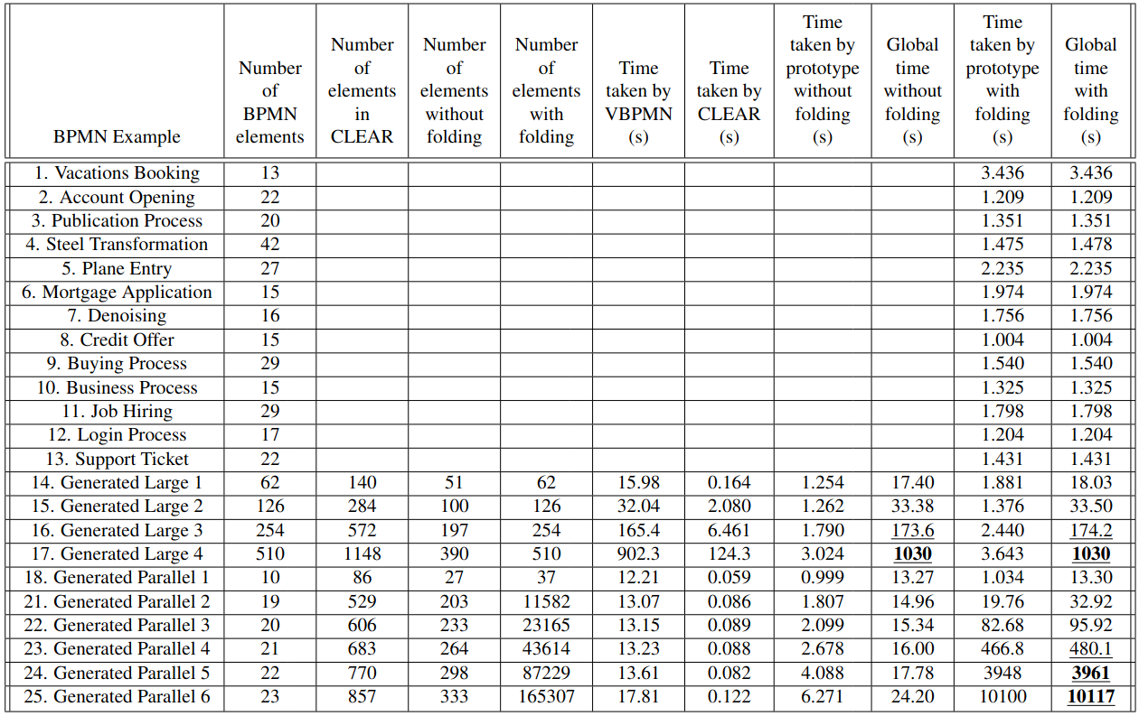
Implementation – Performance study
Worst-case execution time for real-world processes is 3s!
For a BPMN process containing 254 nodes, the total execution time approximates 3m, but only 2s are taken by the prototype!
For a BPMN process containing 43k nodes, the prototype starts showing its limits with an execution time of 8m.

Slide 25
Plan
Preliminaries
BPMN sub-syntax
Model checking & Colored LTS
Full process
Solving approach
Global representation
Matching analysis
Unfolding only
Unfolding + Folding
Implementation
Generalities
Empirical study
Performance study
Conclusion

Slide 26
Conclusion
To conclude, we proposed in our approach a way of expressing all the counterexamples of a temporal logic property in BPMN notation, while providing the user a BPMN process that is as syntactically close as possible to the initial one.
We also provided an automated tool implementing all the proposed solutions, for which we assessed the scalability through a performance study.
Short-term improvements:
Handle inclusive gateways
Mid-term improvements:
Support liveness properties

Slide 27

Questions

